Slide 1
Capstone Engagement
Assessment, Analysis, and Hardening of a Vulnerable System By Edgar Argueta

Slide 2
Table of Contents
This document contains the following sections:
01
Network Topology
02
Red Team: Security Assessment
03
Blue Team: Log Analysis and Attack Characterization
Hardening: Proposed Alarms and Mitigation Strategies
04

Slide 3
Network Topology
3

Slide 4
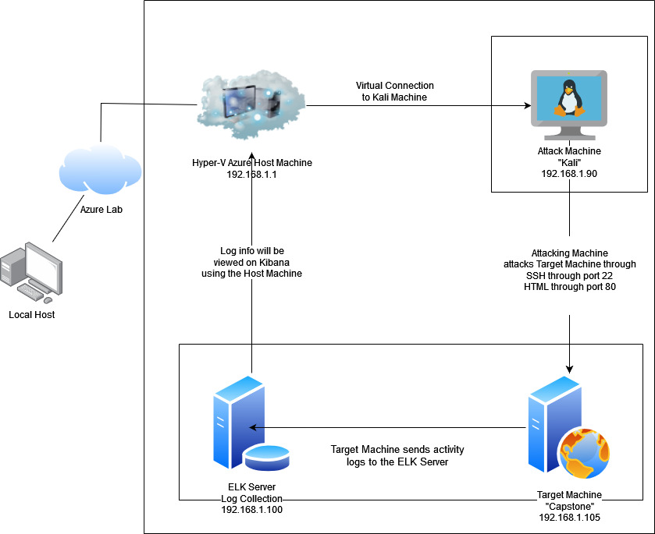
Network Topology
[Insert Here]
Use draw.io to create a diagram of the network.
Add your diagram to this slide and fill out the data in the sidebar.
Network
Address Range: 192.168.1.0/24
Netmask: 255.255.255.0
Gateway: 192.168.1.1
Machines
IPv4: 192.168.1.90
OS: Linux
Hostname: Kali
IPv4: 192.168.1.105
OS: Linux
Hostname: Capstone
IPv4: 192.168.0.100
OS: Linux
Hostname: ELK
IPv4: 192.168.1.1
OS: Windows
Hostname:
Red vs Blue

Slide 5

Red Team
Security Assessment
5

Slide 6
Recon: Describing the Target
Nmap identified the following hosts on the network:
Hostname | IP Address | Role on Network
Capstone | 192.168.1.105 | Web Server/Target Machine
Kali | 192.168.1.90 | Attack Machine
ELK | 192.168.1.100 | Logs Data/Attack Monitoring
ML-REFVM-684427 | 192.168.1.1 | Virtual Host Machine

Slide 7
Vulnerability Assessment
The assessment uncovered the following critical vulnerabilities in the target:
Vulnerability | Description | Impact
Weak Password Policy/Brute Force Attacks | Weak password was found in “rockyou.txt” wordlist No lockout for failed password attempts allowed for brute force attacks | Brute Force resulted in our team gaining Ashton’s password This provided us access to /secret_folder/ and WebDav
Open Ports | Port 80 and Port 22 were open Open ports can leave a network vulnerable to attacks that can lead to private information being exposed or lossed | Port 80 was utilized to launch a brute force attack SSH on to network through port 22 Exploiting both of these open ports resulted in having access to secret files and folders
Reverse Shell Backdoor | Deployed a reverse shell payload on the web server undetected by the firewalls | Gained remote access to the Capstone Apache web server with the reverse shell backdoor

Slide 8
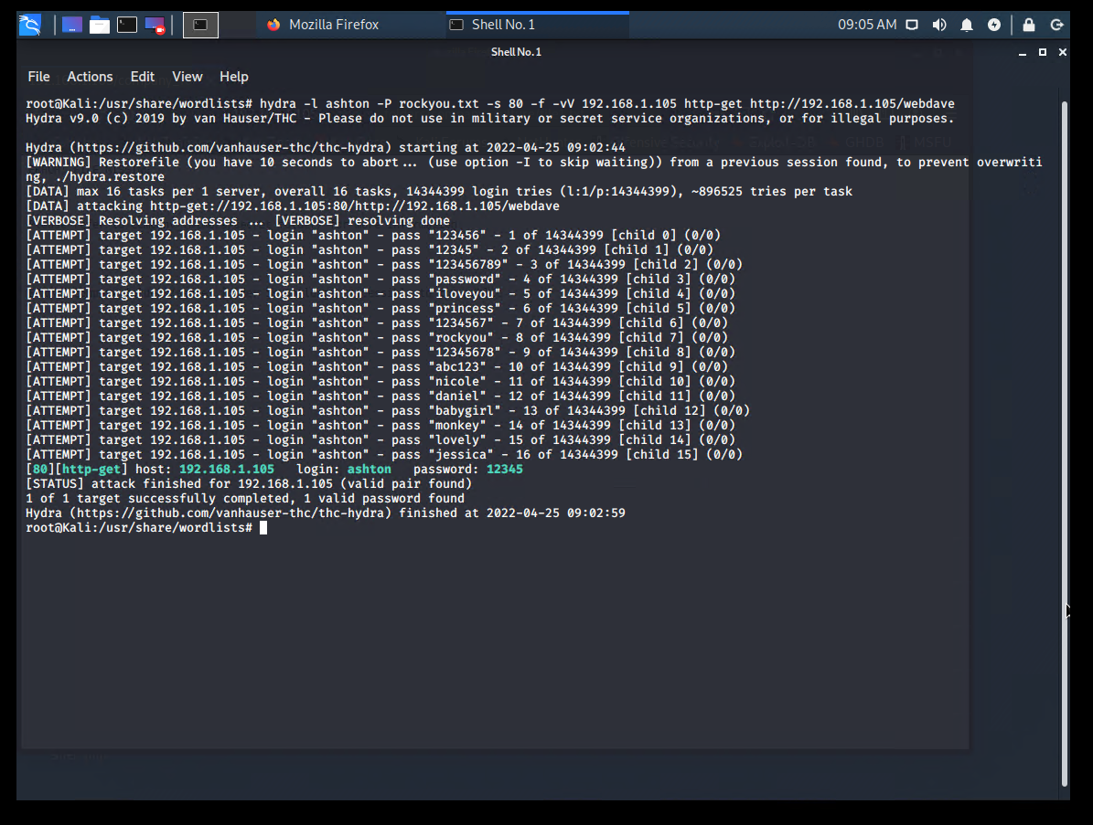
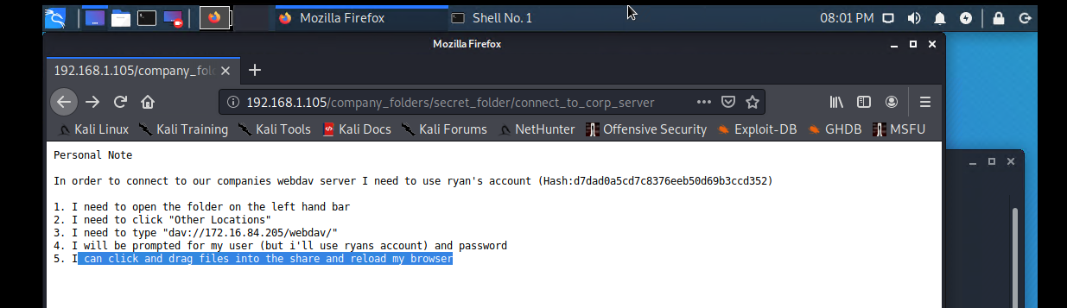
Exploitation: Weak Password Policy
hydra -l ashton -P rockyou.txt -s 80 -f -vV
192.168.1.105 http-get http://192.168.1.105/webdav
The Hydra tool is a network login cracker and works by
using different approaches to perform brute-force
attacks in order to guess the correct username and
password combination.
01
Access to Server via Webpage was obtained
The Dirb command was utilized to discover any
hidden directories located on the target website.
hydra provided a correct username and password
combination. The credentials Were then utilized to
gain access to the server via
the webpage and a secret
folder was discovered revealing
a method to deliver to a reverse
shell payload we created
utilizing the msfvenom
command.
02

Slide 9
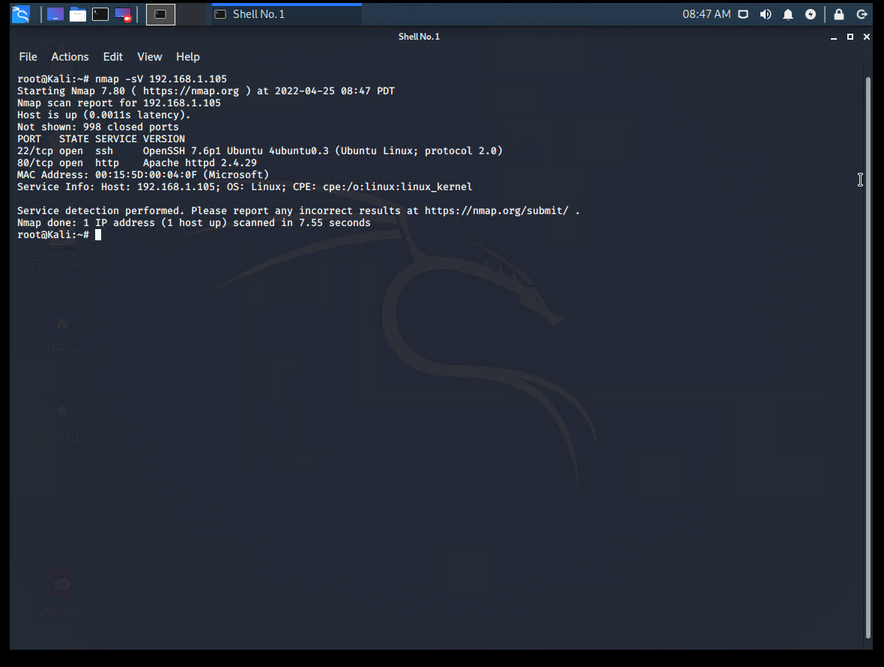
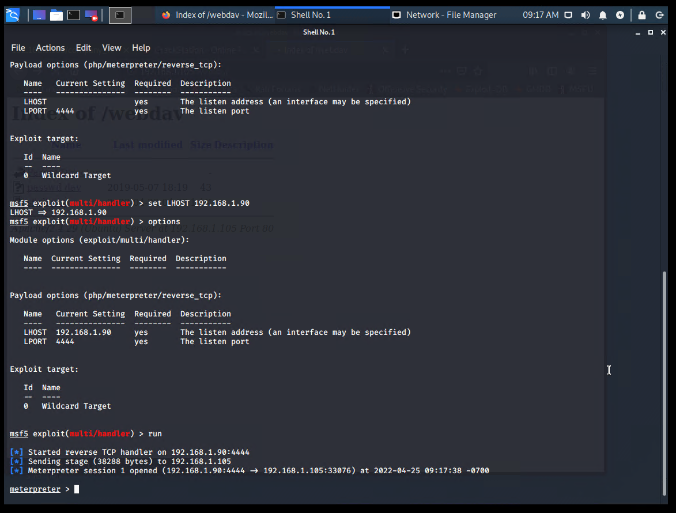
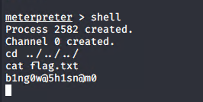
Exploitation: Open Ports
01
Port 80 and 22 Open
Nmap -sV 192.168.1.105 revealed
both port 80 and port 22 were left
open and vulnerable to exploitation
02
Port 80 Utilization
Hydra utilized port 80 to launch
previously described brute force
attack. Port 80 was also utilized to
gain access to “dav://192.168.1.
105/webdav/”, which was utilized
to deliver the PHP Reverse Shell
Payload.
03
Msfconsole
Metasploit was used to establish
the meterpreter connection to
target machine after the payload
was delivered and launched. A
shell channel was then established
to navigate the directories and
capture the flag.

Slide 10
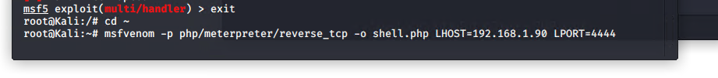
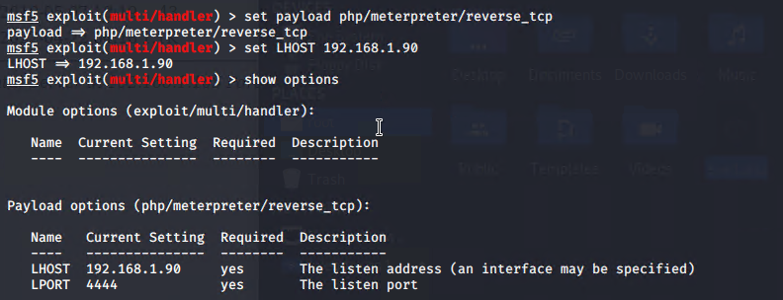
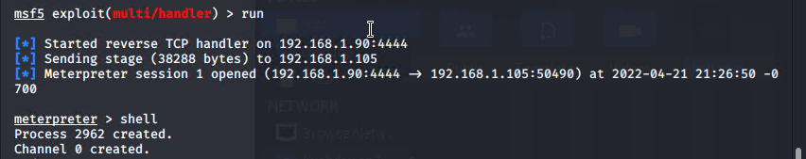
Exploitation: Reverse Shell Backdoor
msfvenom
The payload was created and uploaded by utilizing msfvenom. Msfvenom is a Metasploit command line tool used to generate and output all of the various types of shell code found in Metasploit.
msfvenom payload: php/meterpreter/reverse_tcp
This is a staged payload used to gain meterpreter access to a compromised system.
01
02
Achievements
Established remote listener.
Deployed reverse shell backdoor on Capstone Apache web server.
Root access was gained on Capstone server which resulted in capturing the flag.

Slide 11

Blue Team
Log Analysis and Attack Characterization
11

Slide 12

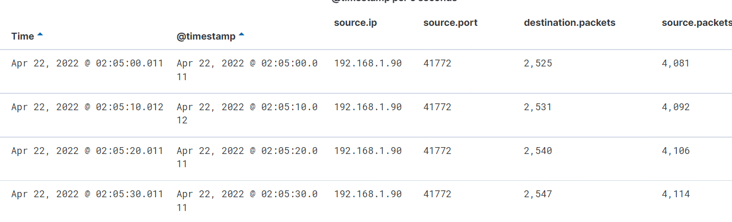
Analysis: Identifying the Port Scan
The scan originated on April 22, 2022 at 02:05 am from IP address 192.168.1.90
4,114 packets were sent from 192.168.1.90
Multiple ports being requested confirms a port scan was initiated.

Slide 13
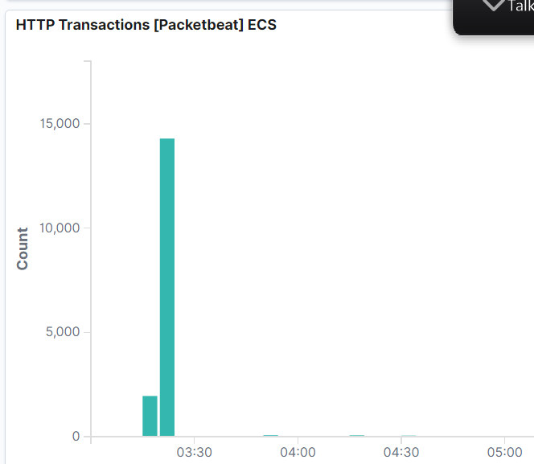
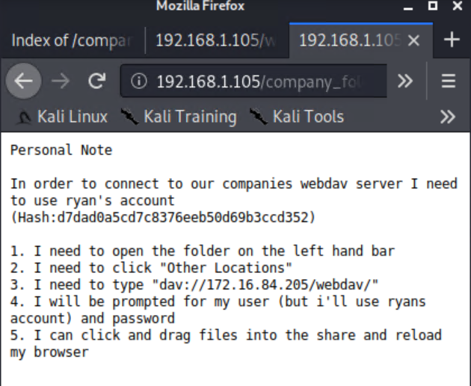
Analysis: Finding the Request for the Hidden Directory
The request occurred on Apr 22, 2022 at 03:20 and made 14,279 request. An earlier request also happened at 03:15 and made 1,885 requests.
The file that was requested was the secret folder in within the company folder. It contained instruction on how to login into the WebDAV server using Ryan’s account. It also contained Ryan’s hashed password.

Slide 14
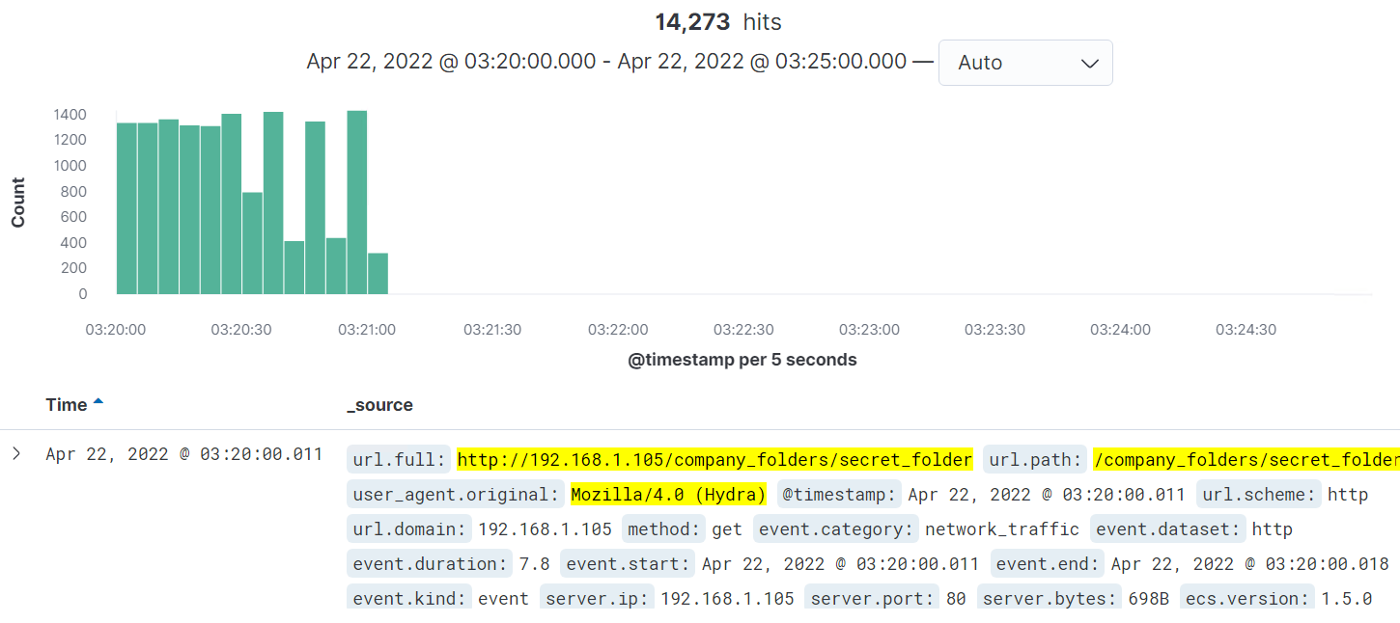
Analysis: Uncovering the Brute Force Attack
14,273 requests were made before the attacker could crack the password. Out of the 14,273, the attacker was able to successfully crack the password only 4 times.

Slide 15
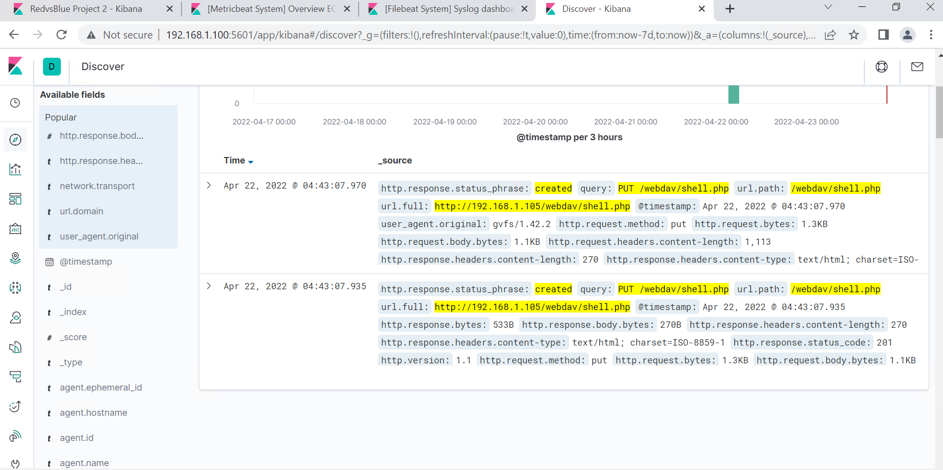
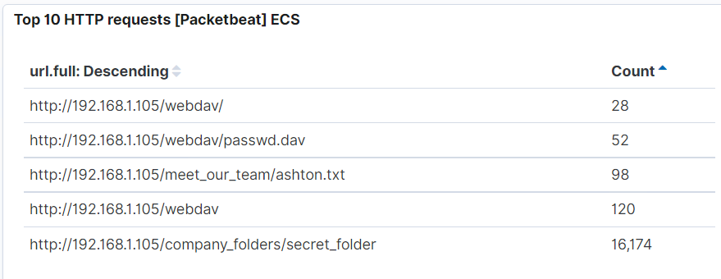
Analysis: Finding the WebDAV Connection
28 requests were made to the WebDAV directory.
The file that was requested was the shell.php which was added by the red team.

Slide 16
Blue Team
Proposed Alarms and Mitigation Strategies
16

Slide 17
Mitigation: Blocking the Port Scan
What kind of alarm can be set to detect future port scans?
Set an alert for when a firewall detects port scans or any consecutive requests.
What threshold would you set to activate this alarm?
10 port scans in less than a minute.
What configurations can be set on the host to mitigate port scans?
An IPS from a firewall can detect port scans and shut them down.
Describe the solution. If possible, provide required command lines.
Filtering traffic from an IP triggered by the IPS can effectively mitigate port scans.

Slide 18
Mitigation: Finding the Request for the Hidden Directory
What kind of alarm can be set to detect future unauthorized access?
An alert for any machine that attempts to access this directory.
What threshold would you set to activate this alarm?
The threshold for this alarm would just be 1, for any attempt.
What configuration can be set on the host to block unwanted access?
Encrypting data contained within directory.
Describe the solution. If possible, provide required command lines.

Slide 19
Mitigation: Preventing Brute Force Attacks
What kind of alarm can be set to detect future brute force attacks?
An alert if a 401 Unauthorized error is returned.
What threshold would you set to activate this alarm?
If 5 errors are returned.
What configuration can be set on the host to block brute force attacks?
Limit failed login attempts
Strengthen passwords.
Describe the solution. If possible, provide the required command line(s).
Configure account policies on the server to limit failed login attempts before locking the user.

Slide 20
Mitigation: Detecting the WebDAV Connection
What kind of alarm can be set to detect future access to this directory?
Set an alarm that activates on any unauthorized IP address attempting to access the WebDAV directory.
What threshold would you set to activate this alarm?
The threshold would be just 1.
What configuration can be set on the host to control access?
Creating a whitelist of authorized IP addresses.
Describe the solution. If possible, provide the required command line(s).

Slide 21
Mitigation: Identifying Reverse Shell Uploads
What kind of alarm can be set to detect future file uploads?
Set an alarm that activates when you see any “put” requests to *webdav* from untrusted IPs
What threshold would you set to activate this alarm?
The threshold would be 1
What configuration can be set on the host to block file uploads?
You would only allow access to “secret_folder” from trusted IPs
Describe the solution. If possible, provide the required command line.
You would have to change the httpd.conf file and set which IPs to allow into webdav

